Slide 1
Methods
Kia Babashahi Ashtiani

Slide 2
Overview
Methods
Methods with a return type
Methods without a return type
Strings

Slide 3

Functions in mathematics=Methods
F(x)=x
F(x)=2x
G(y)=2y+3
Average(x,y,z)=$\frac{x+y+z}{3}$
Given an input(it can also be a tuple like average function) produces a single output.

Slide 4

Recap
Which one of these is a function?
$f\left(x\right)=2x+5$
$f\left(x\right)=x^{2}$
$f\left(x\right)=\left\{\begin{aligned}−1, x≤0 \\ &1, x≥0\end{aligned}\right.$

Slide 5
Why are functions in math?
You write the definition of f(x) once and then call it on different inputs.
f(2), f(3), …. .
Makes your computation more readable.
It helps you focus on the big picture. Instead of going through a lot of computation you will look at the name and understand the ideas:
Avg(Avg(2,3,4,5), pow(2,4), sin(45)).
Avg=Average,
Pow=power
sin=sinus

Slide 6
What about coding?
Same story:
Helps you write shorter code.
Helps you debug better.
Makes the code more readable.
Allows modularity.
Functional programming is a branch of theoretical computer science and software engineering.

Slide 7
Write the following program without using the packages of java
1-The user inputs 4 numbers, find their average.
2-After you have the average, find the max number amongst them.
3-Ask the user to enter three numbers.
4- Find the maximum amongst the three numbers entered and the old average.
5-The user inputs 4 other numbers, find the average.
Pay attention that you probably must write the code to find the average and max twice and if you don`t use control statements and pre-defined Java functions, it is not going to be that short of a code relative to the rest of the codes you have seen so far.

Slide 8
implement the same using Math.max and Math.AVG
This code will be shorter.
In the past you have been using methods without knowing that they are called methods.
max, min,avg, abs, pow, cos, sin,….
In this lecture you will learn how to write user defined functions.

Slide 9
Methods=functions
I will use the terms methods and functions interchangeably throughout this course.
Why are the methods in the previous slide actual methods(functions)?
Given an input they return only one unique number.
Methods are also definable for Boolean variables, Strings and almost any other type in Java.
Concat(“hello”,”world”)=“helloworld”
Conjuction(true,false)=false

Slide 10
Methods in java
Have a return type
All the methods you have seen so far.
They will spit out something of a particular type.
Think of it as throwing something at someone. The person catching it needs to know what type of thing is being thrown at them to react properly. When playing baseball you don`t through watermelons or the person catching it will go through some heavy and terrible experience.
Do not have a return type.
Changes the memory address of something.
Does internal changes.
Prints something.

Slide 11
Functions with return type general format
public type functionName(type arg1, type arg2, …,type argn){
The body of the function.
return something;
}
Until you learn object-oriented programming you have to write your functions in the main class, under the main function and the format is:
public static type functionName(type arg1, type arg2, …,type argn){
The body of the function;
return something;
}

Slide 12
What is optional what is not
When defining a function with a return type the following must be written:
Return type,
The keyword static until you learn OOP,
The function`s name,
If your function takes input arguments the type of each one of them.
The return keyword;
Not all functions accept inputs. So having inputs is optional

Slide 13

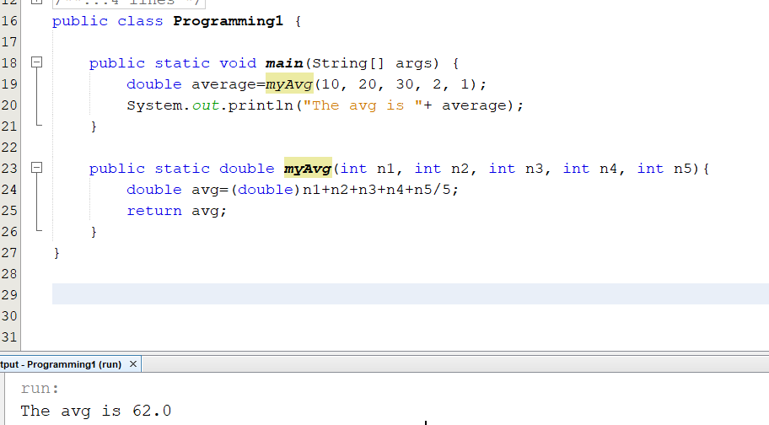
Example : AVERAGE of 5 numbers
The function is defined outside of the main class.
When calling the method just input the numbers in arg list.

Slide 14
Where to define the function
Define your function outside the main function but in the same class.
Do not define your functions inside of another function.

Slide 15

Calling it in the main function
When calling the function just pass the elements to it.
No need to type the arguments when calling it.
Keep in mind that your function is returning something. So you can print it directly or store it in some variable.
Like math:
When defining you write: $f\left(x,y\right)=4x+5y+xy$
When calling you write f(2,3) which will return 4*2+5*3+6=29

Slide 16
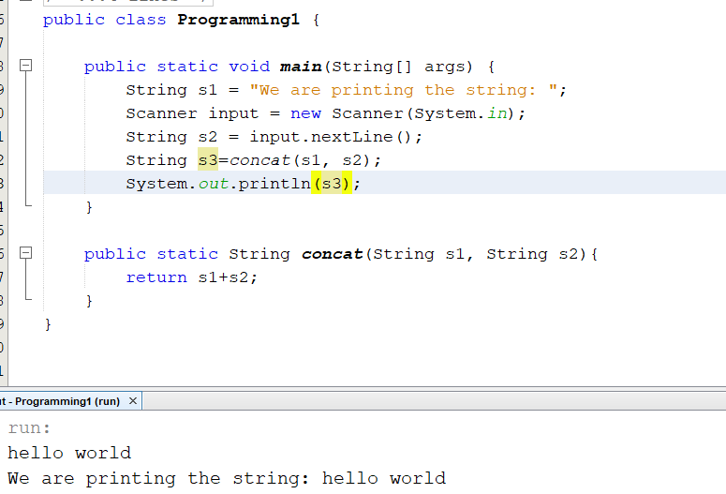
Example with string concatenation
You can print s3 or just type
System.out.println(concat(s1,s2));

Slide 17
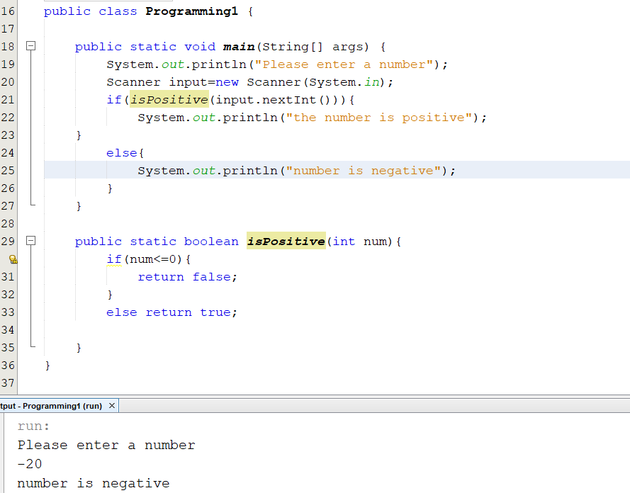
Example with Boolean operators
You can use the output immediately in line 21 since you are returning something.

Slide 18
Functions with return types but no arguments
Each function might or might not have input arguments
In the next slide your will see two examples of such functions.
Keep in mind that the input arguments are optional and depend on the problem statement.
If you are asked to write a method that takes two input arguments, your method needs to take two input arguments. If it has not been stated how many args to take, either its up to you or it does not need any inputs args.

Slide 19
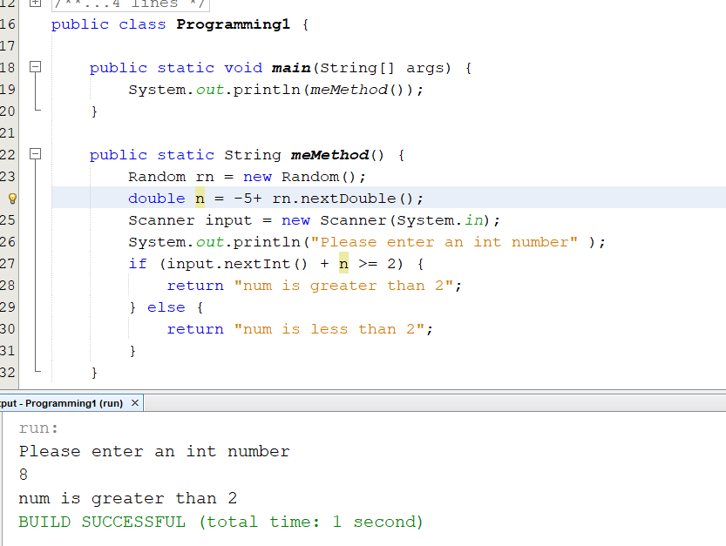
Reading using a function
The following code generates random numbers and reads from the user in method myMethod.
No args for method myMethod.
Any method can have no or many arguments depending on its application.

Slide 20
Functions without return types
These types of function do not return anything.
Using these types of functions you can do many things such as :
Printing a statement (printing a statement is not the same as returning a value).
Modifying reference type variables and addresses.
Doing arithmetical and logical operations and display the answer or not.

Slide 21
Functions without return types
These functions do not return anything.
They have a return type which is called void.
They do not contain the return keyword in their body.
The rest is quite similar functions with return arguments.

Slide 22
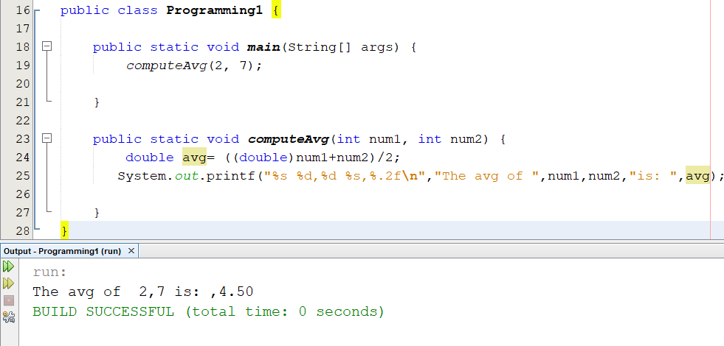
Average void
Write a method that computes the average of two numbers but does not return them and just prints them.

Slide 23
Void functions general type
public void functionName(type arg1, type arg2, …,type argn){
The body of the function.
}
Until you learn object-oriented programming you have to write your functions in the main class, under the main function and the format is:
public static void functionName(type arg1, type arg2, …,type argn){
The body of the function;
}

Slide 24
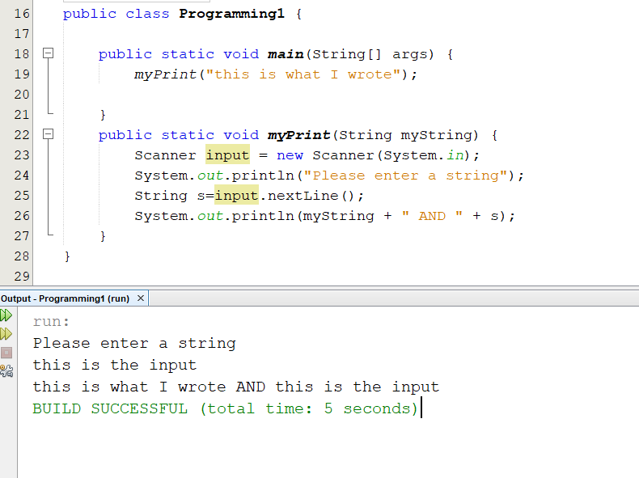
Void function to print
You can also just print something and that’s it.

Slide 25
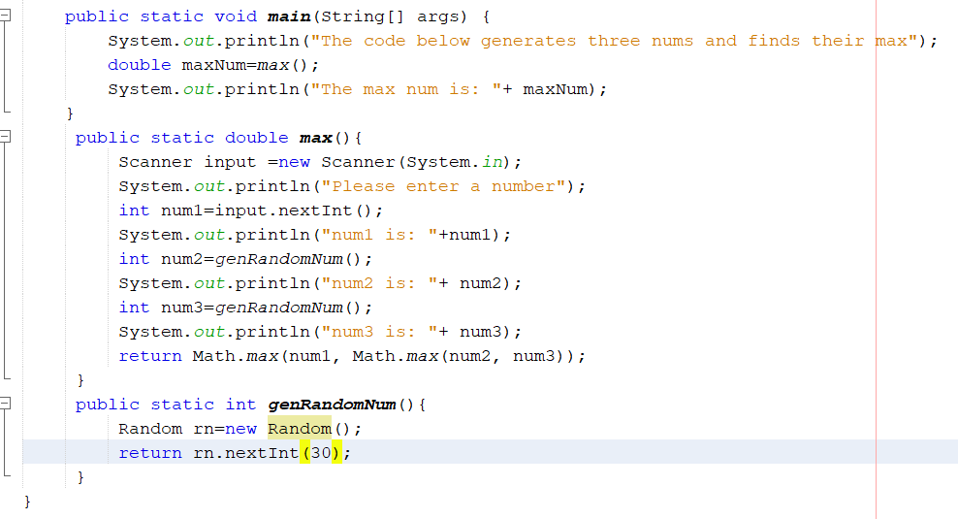
Nested methods
Input one number and generate two random numbers then compute their max.

Slide 26
Scope of variables
Variables can only be accessed within the block of code or scopes that they are defined in.
The blocks are determined by { }.
A variable can be local to a certain scope or global to a scope.
We will talk about global in the future.

Slide 27
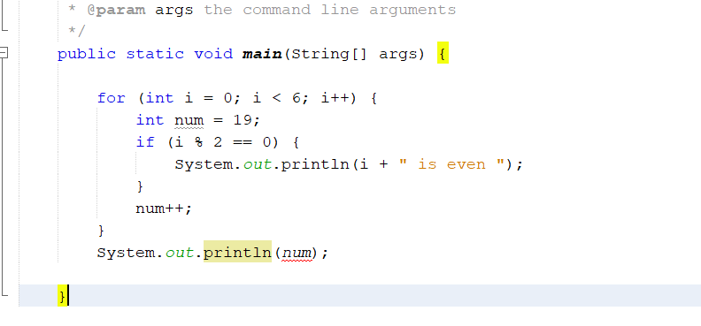
Local vs global
Num is defined within for, so you can not access it under for.

Slide 28
So what happens if we take num out
Num will become local to all the commands inside the main function under its definition.
In the previous case num was only local to the commands in the for loop written under its definition.

Slide 29
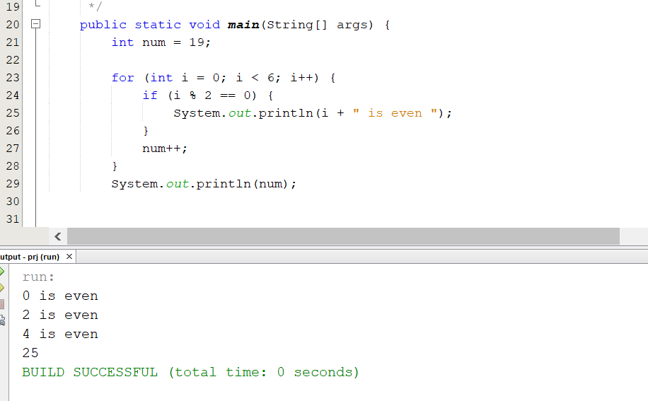
Accessing num
Num is now local to all the main commands.

Slide 30
What are other scopes?
We know control statements define scopes.
Functions as well have scopes: {}
If a variable is defined in a function, it is only accessible in that function.
Main is a function (method) so you can not access its local variables in other functions.

Slide 31
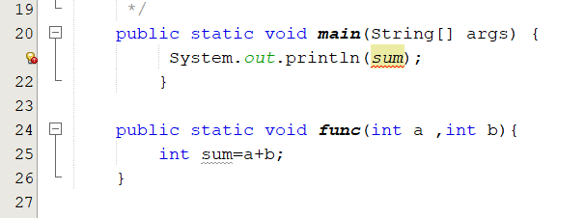
Local vs global
You can not access sum in main or any other function except func since it is local to func.

Slide 32
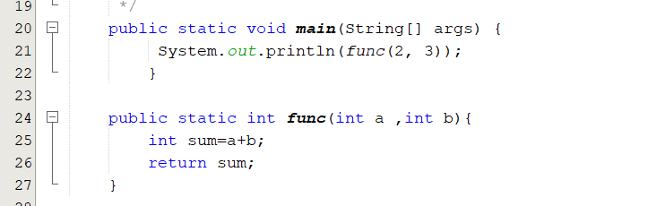
How to fix the previous issue? RETURN sum.

Slide 33
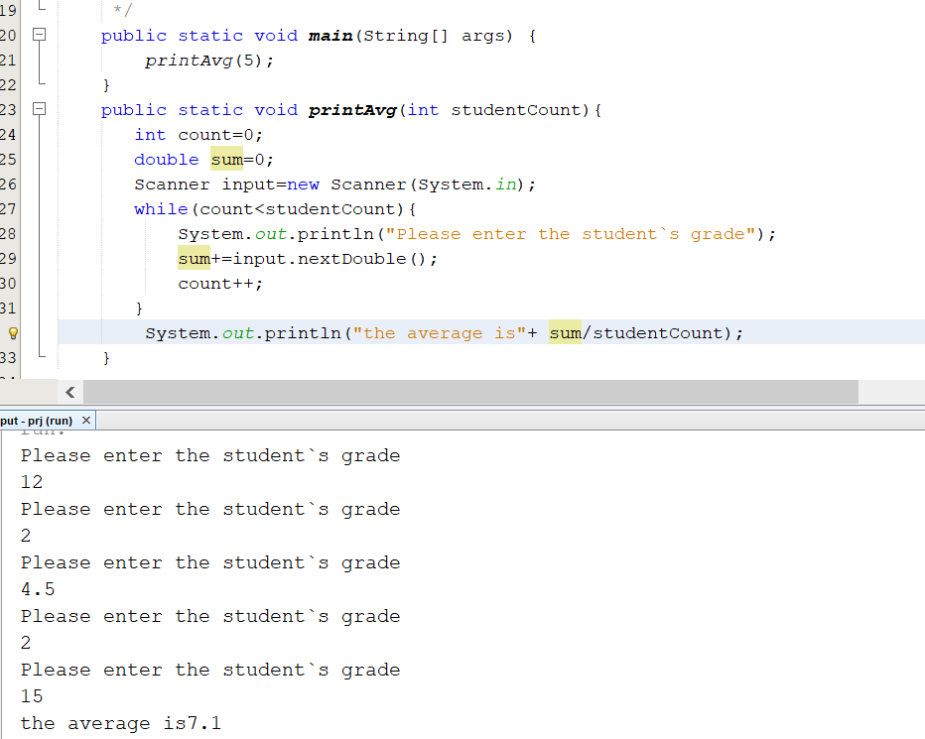
Methods using control statements 1
Read the student grades and find their average then print them.
We are passing the count in the main as 5. So we are asking the machine to compute f(2) for example or printAvg(5) in our case.
The machine will then compute printAvg(5).

Slide 34
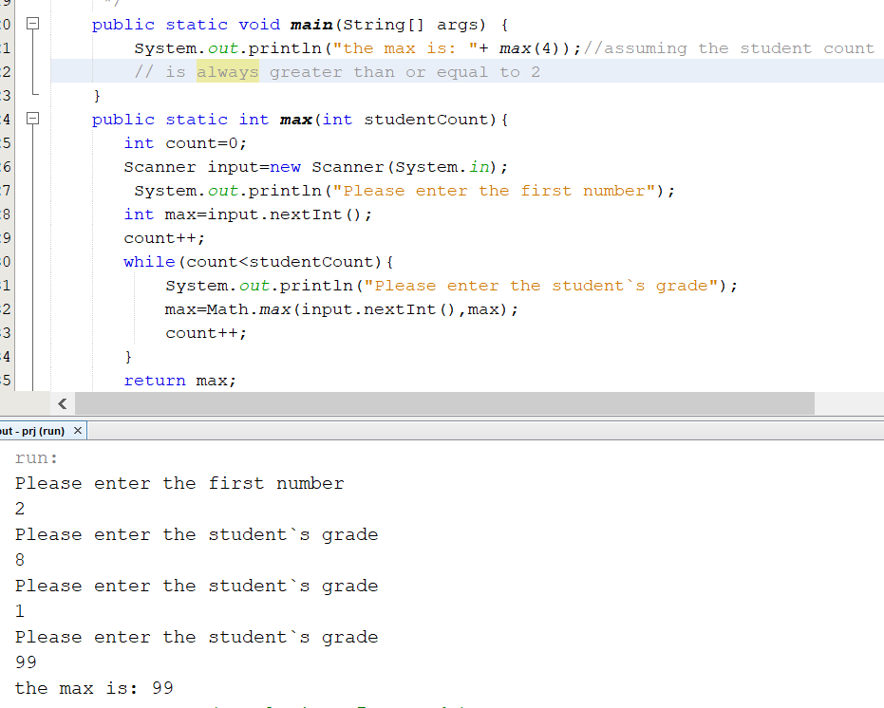
Find the max of the grades
Ask the user to input some numbers and find their max then return and print them.

Slide 35
Summary
Methods are of two form
With return type.
Without return type (void): Used to print or modify reference type vars.
Variables are accessible within their scope so they might be local to a scope.
You can use methods in a nested structure.
You can combine methods with control statements.

